Slide 1
Recurrent Neural Networks (RNNs)
2023. 1. 28.
윤지영 (얏홍 from 캐글 스터디)

Slide 2
1
2
3
4
5
Sequential Data Modeling
Formulating RNNs
Applications of Sequence Models
Vanishing Gradient Problem
Long Short-Term Memory (LSTM)

Slide 3

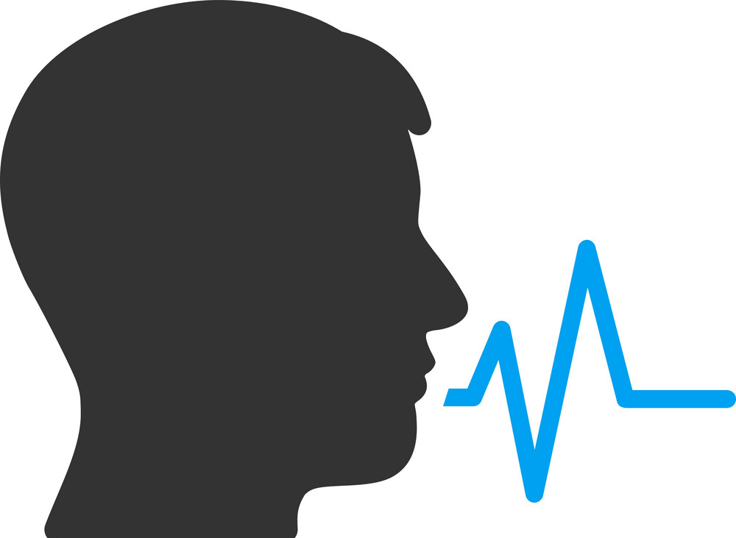

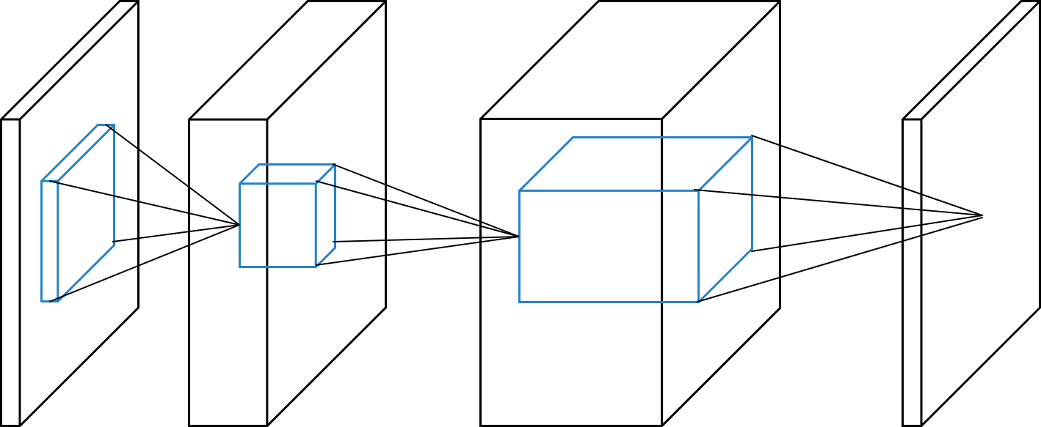
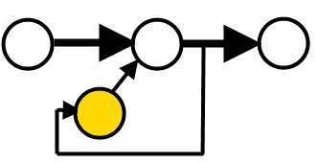
Example of Sequential Data
Speech, text, video, …
Stock exchange
Biological measurements
Climate measurements
User behavior in websites
DNN for sequential data
Convolutional neural networks (CNN)
Finding local features from a sequence
Recurrent neural networks (RNN)
Capturing the current feature using the previous features

Slide 4
Sequential Data Modeling
Next step prediction
Sentence classification
Machine translation
Model
What is your
name
Model
This movie is exciting
Positive/Negative
Model
Deep learning is fun.
기계 학습은 재미있다.

Slide 5
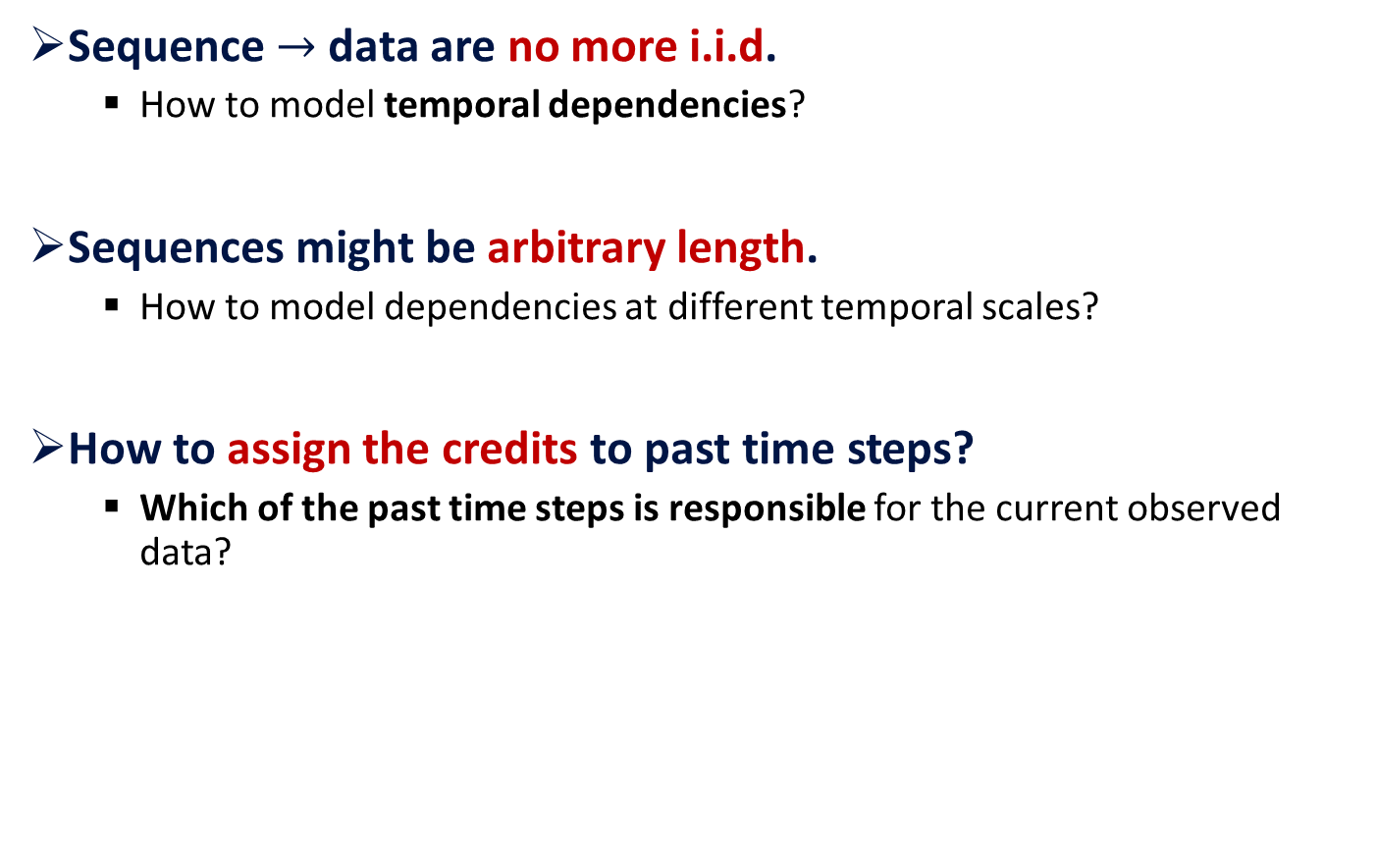
What Makes Sequences Special?
Sequence $→$ data are no more i.i.d.
How to model temporal dependencies?
Sequences might be arbitrary length.
How to model dependencies at different temporal scales?
How to assign the credits to past time steps?
Which of the past time steps is responsible for the current observed data?

Slide 6
Challenge of Sequential Data Modeling
Sequences might be arbitrary or even infinite lengths.
To represent the past influence, we should keep a summary of the past.
Need a memory as a representation of the past.

Slide 7






Graphical Representation of RNNs
$h_{1}=f\left(u_{1}x_{1}\right)$
$y_{1}=g\left(v_{1}h_{1}\right)$
$$y_{1}$$
$$v_{1}$$
$$h_{1}$$
$$u_{1}$$
$$x_{1}$$

Slide 8



















Graphical Representation of RNNs
$h_{t}$: memory vector that stores the previous state.
$h_{t}=f\left(u_{t}x_{t}+w_{t−1}h_{t−1}\right)$
$\left.o_{t}=g(v_{t}h_{t}\right)$
Je
suis
un
garçon
$$y_{1}$$
$$y_{2}$$
$$y_{3}$$
$$y_{4}$$
$$v_{1}$$
$$v_{2}$$
$$v_{3}$$
$$v_{4}$$
$$w_{1}$$
$$w_{2}$$
$$w_{3}$$
$$h_{1}$$
$$h_{2}$$
$$h_{3}$$
$$h_{4}$$
$$u_{1}$$
$$u_{2}$$
$$u_{3}$$
$$u_{4}$$
$$x_{1}$$
$$x_{2}$$
$$x_{3}$$
$$x_{4}$$
I
am
a
boy

Slide 9
Graphical Representation of RNNs
This model has no problem with arbitrary sequence length.
However, we have different parameters for each state.
The input shapes are same for each state.
Our solution: what about using same parameters for each state?
Je
suis
un
garçon
$$y_{1}$$
$$y_{2}$$
$$y_{3}$$
$$y_{4}$$
$$v_{1}$$
$$v_{2}$$
$$v_{3}$$
$$v_{4}$$
$$w_{1}$$
$$w_{2}$$
$$w_{3}$$
$$h_{1}$$
$$h_{2}$$
$$h_{3}$$
$$h_{4}$$
$$u_{1}$$
$$u_{2}$$
$$u_{3}$$
$$u_{4}$$
$$x_{1}$$
$$x_{2}$$
$$x_{3}$$
$$x_{4}$$
I
am
a
boy

Slide 10

















Graphical Representation of RNNs
$$y_{1}$$
$$y_{i−1}$$
$$y_{t}$$
$$y_{t}$$
$$v_{1}$$
$$v_{i−1}$$
$$v_{1}$$
$$V$$
$$w_{1}$$
$$w_{i−2}$$
$$w_{i−1}$$
$$W$$
$$h_{1}$$
……
$$h_{i−1}$$
$$h_{t}$$
$$h_{t}$$
……
$$u_{1}$$
$$u_{i−1}$$
$$u_{1}$$
$$U$$
$$x_{1}$$
$$x_{i−1}$$
$$x_{t}$$
$$x_{t}$$

Slide 11
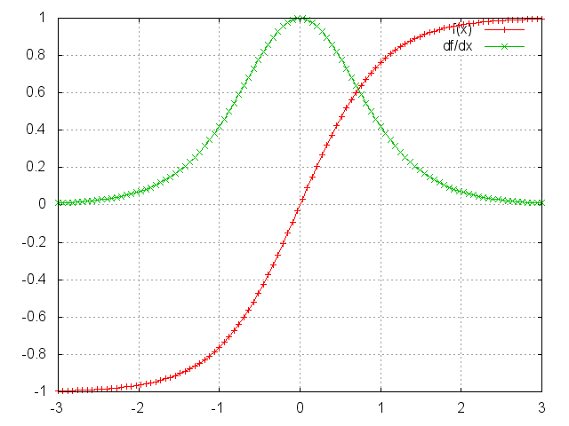



Formulation of RNNs
Usually tanh function is used for RNN activation function.
$h_{t}=f\left(Ux_{t}+Wh_{t−1}\right)$
$\left.y_{t}=g(Vh_{t}\right)$
$h_{t}=tanh\left(Ux_{t}+Wh_{t−1}\right)$
$\left.y_{t}=g(Vh_{t}\right)$
$$y_{t}$$
$$V$$
$$W$$
$$h_{t}$$
$$U$$
$$x_{t}$$
Tanh function

Slide 12















Key Characteristics of RNNs
Long-term dependency
$x_{1}\sim x_{t−1}$ are encoded into $h_{t−1}$.
$h_{t−1}$ has the information on the past and it is a context to process $x_{t}$.
Output
$$y_{1}$$
$$y_{2}$$
$$y_{t−1}$$
$$y_{t}$$
$$V$$
$$V$$
$$V$$
$$V$$
$$W$$
$$W$$
$$W$$
Hidden layer
$$h_{1}$$
$$h_{2}$$
……
$$h_{t−1}$$
$$h_{t}$$
$$U$$
$$U$$
$$U$$
$$U$$
Input
$$x_{1}$$
$$x_{2}$$
$$x_{t−1}$$
$$x_{t}$$

Slide 13
Various RNN Models
Many-to-one
Synced many-to-many
Many-to-many
Many-to-one
Synced many-to-many
Many-to-many

Slide 14
Many-to-One Model
Input: a sequence of words
Output: label
Example: sentence classification
Pos/Neg
$$o$$
$$h_{1}$$
$$h_{2}$$
$$h_{3}$$
$$h_{4}$$
$$h_{5}$$
$$x_{1}$$
$$x_{2}$$
$$x_{3}$$
$$x_{4}$$
$$x_{5}$$
This
movie
is
extremely
exciting.

Slide 15
Synced Many-to-Many Model
Each token produces its corresponding token.
Example
Neural network language model
Part-of-speech (POS) tagging
$$o_{1}$$
$$o_{2}$$
$$o_{3}$$
$$o_{4}$$
$$o_{5}$$
$$h_{1}$$
$$h_{2}$$
$$h_{3}$$
$$h_{4}$$
$$h_{5}$$
$$x_{1}$$
$$x_{2}$$
$$x_{3}$$
$$x_{4}$$
$$x_{5}$$

Slide 16
Many-to-Many Model
Sequence-to-Sequence (Seq2Seq) model
A sequence of words are encoded in a single vector.
The single vector is decoded to a sequence of words.
Example
Speech recognition
Machine translation
Document summarization
$$o_{1}$$
$$o_{2}$$
$$h_{1}$$
$$h_{2}$$
$$h_{3}$$
$$h_{4}$$
$$h_{5}$$
$$x_{1}$$
$$x_{2}$$
$$x_{3}$$

Slide 17
Seq-to-Seq Model
The neural network architecture is called sequence-to-sequence (a.k.a. seq2seq) and it involves two RNNs.
Encoder-decoder approach
1.2
-0.1
$$⋮$$
1.1
2.4
5.8
Input text
Translated text
Encoder
Decoder

Slide 18
Seq-to-Seq Model
Encoding RNN for the source sentence
Decoding RNN for the target sentence
$$o_{1}$$
$$o_{2}$$
Encoder
$$V$$
$$V$$
$$h_{1}$$
$$W_{1}$$
$$h_{2}$$
$$W_{1}$$
$$h_{3}$$
$$W_{2}$$
$$h_{4}$$
$$W_{2}$$
$$h_{5}$$
$$U$$
$$U$$
$$U$$
$$x_{1}$$
$$x_{2}$$
$$x_{3}$$

Slide 19
Seq-to-Seq Model
Encoding RNN for the source sentence
Decoding RNN for the target sentence
$$o_{1}$$
$$o_{2}$$
$$V$$
$$V$$
$$h_{1}$$
$$W_{1}$$
$$h_{2}$$
$$W_{1}$$
$$h_{3}$$
$$W_{2}$$
$$h_{4}$$
$$W_{2}$$
$$h_{5}$$
$$U$$
$$U$$
$$U$$
$$x_{1}$$
$$x_{2}$$
$$x_{3}$$
Decoder

Slide 20
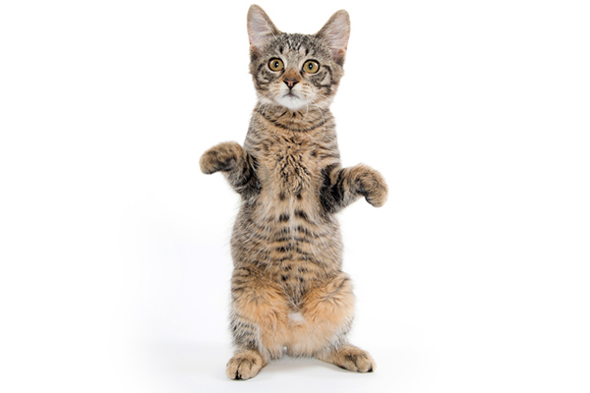
Example: Encoder-Decoder Approach
Input: image
Output: sentence (a sequence of words)
Example: image captioning
A
cat
is
amazingly
standing
$$o_{1}$$
$$o_{2}$$
$$o_{3}$$
$$o_{4}$$
$$o_{5}$$
ConvNet
$$h_{1}$$
$$h_{2}$$
$$h_{3}$$
$$h_{4}$$
$$h_{5}$$
$$x$$

Slide 21

Advantage of RNNs
Explicitly use the prior knowledge that the sequential data can be processed in the same way.
Hidden state: a lossy summary of the past
Use the same computational function and parameters across different time steps of the sequence.
Greatly reduce the capacity and good for generalization in learning

Slide 22
Training RNNs is Difficult.
Gradient vanishing problem
After a few time steps, the gradients become almost 0.
Gradient exploding problem
After a few time steps, the gradients become almost huge.
$\frac{∂h_{t}}{∂h_{i}}=\frac{∂h_{i+1}}{∂h_{i}}⋅$ $\frac{∂h_{i+2}}{∂h_{t+1}}⋅$ $\frac{∂h_{i+3}}{∂h_{i+2}}⋅$… $⋅$ $\frac{∂h_{t}}{∂h_{t−1}}$
< 1
< 1
< 1
$\frac{∂h_{t}}{∂h_{i}}=\frac{∂h_{i+1}}{∂h_{i}}⋅$ $\frac{∂h_{i+2}}{∂h_{t+1}}⋅$ $\frac{∂h_{i+3}}{∂h_{i+2}}⋅$… $⋅$ $\frac{∂h_{t}}{∂h_{t−1}}$
> 1
> 1
> 1

Slide 23
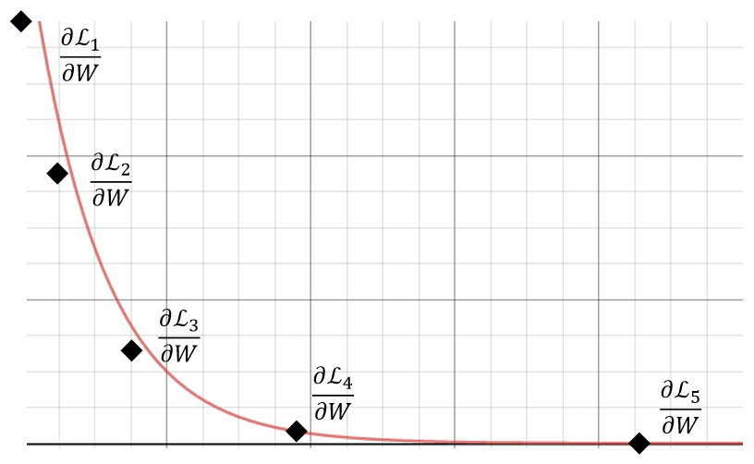
Why are Vanishing Gradients Bad?
Exponentially smaller contribution for longer terms
The weights quickly learn to model short-term transitions and ignore long-term transitions.
Can be undesirable if the distant past is a key factor.

Slide 24











Recap: Key Characteristics of RNN
Long-term dependency of vanilla RNN
$x_{1}\sim x_{t−1}$ are encoded into $h_{t−1}$.
$h_{t−1}$ has the information on the past and it is a context to process $x_{t}$.
Output
$$o_{1}$$
$$o_{2}$$
$$o_{n−1}$$
$$o_{n}$$
$$V$$
$$V$$
$$V$$
$$V$$
$$W$$
$$W$$
$$W$$
Hidden layer
$$h_{1}$$
$$h_{2}$$
……
$$h_{n−1}$$
$$h_{n}$$
$$U$$
$$U$$
$$U$$
$$U$$
Input
$$x_{1}$$
$$x_{2}$$
$$x_{n−1}$$
$$x_{n}$$

Slide 25












Recap: Key Characteristics of RNN
Long-term dependency of vanilla RNN
The context may exponentially decade or grow.
Usually, it is limited to 10 steps.
It can be difficult to capture the long-term dependency.
Output
$$o_{1}$$
$$o_{2}$$
$$o_{n−1}$$
$$o_{n}$$
$$V$$
$$V$$
$$V$$
$$V$$
$$W$$
$$W$$
$$W$$
Hidden layer
$$h_{1}$$
$$h_{2}$$
……
$$h_{n−1}$$
$$h_{n}$$
$$U$$
$$U$$
$$U$$
$$U$$
Input
$$x_{1}$$
$$x_{2}$$
$$x_{n−1}$$
$$x_{n}$$

Slide 26
Example: Long-Term Dependency
나는, 어제 친구와 놀았고, 그 전날은 가족과 놀이 동산에 가서 좋은 시간을 보내서, 너무 피곤하다.
$$o_{1}$$
$$o_{2}$$
$$o_{m−1}$$
$$o_{m}$$
$$h_{1}$$
$$h_{2}$$
$$h_{m−1}$$
$$h_{m}$$
….
$$x_{1}$$
$$x_{2}$$
$$x_{m−1}$$
$$x_{m}$$

Slide 27
Long Short-Term Memory (LSTM)
$$o_{t}$$
$$o_{t}$$
$$V$$
$$U$$
$$W$$
$$x_{t}$$
$$h_{t−1}$$
$$x_{t}$$
$$h_{t−1}$$
Vanilla RNN
LSTM

Slide 28
How does LSTM Work?
It has long-term memory $c_{t−1}$ and short-term memory $h_{t−1}$.
$$c_{t−1}$$
$$h_{t−1}$$
$$x_{t}$$
$$o_{t}$$

Slide 29
How does LSTM Work?
$$o=σ\left(U^{o}x_{t}+W^{o}h_{t−1}\right)$$
Output gate $o$ is used to control the importance of $\tanh\left(c_{t}\right)$.
$$h_{t}=tanh(c_{t})⨀o$$
$$c_{t−1}$$
$$∗$$
$$+$$
$$c_{t}$$
∗
$$tanh$$
$$f$$
$$g_{t}$$
$$i$$
$$o$$
$$\text{∗}$$
$$h_{t−1}$$
$$h_{t}$$
$$x_{t}$$
$$o_{t}$$

Slide 30
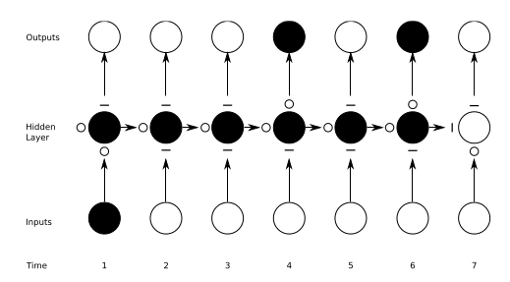
Characteristics of LSTM
How to preserve sequence information?
O: entirely open,
—: entirely closed
Traditional RNNs are a special case of LSTM.
Input gate set to 1 (passing all new information).
Forget gate set to 0 (forgetting all past information).
Output gate set 1 (exposing the entire memory).

Slide 31
Additional Source
“딥러닝을 이용한 자연어 처리 입문”
https://wikidocs.net/book/2155 -> 딥러닝 자연어처리의 교과서

Slide 32
Q & A

